Slide 1
Introduction to the course
Ying shen
Sse, tongji university
Sep. 2016

Slide 2
Lecturer
Ying Shen
Room 314, Jishi Building
Tel: 6958 5491
Email: yingshen@tongji.edu.cn
TA: TBA

Slide 3
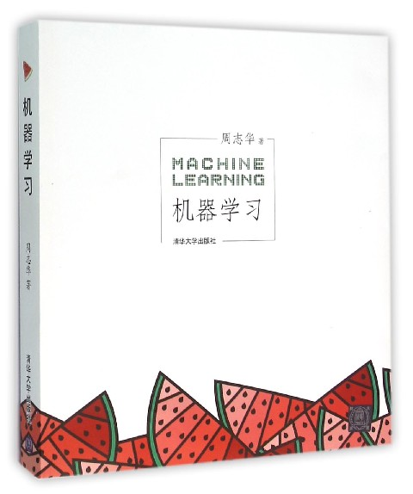
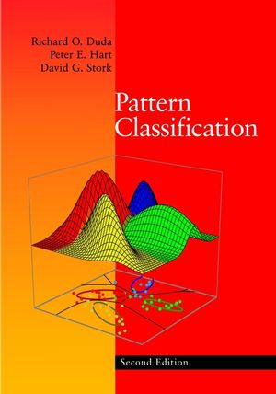
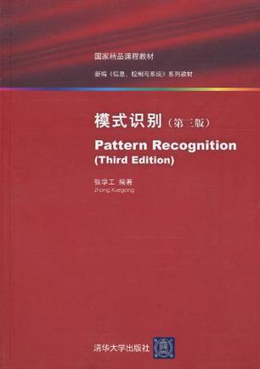
Reference
Main reference:
《机器学习》 (周志华)
Couse slides
Other materials:
Pattern Classification (Richard O. Duda, Peter E. Hart, David G. Stork)
模式识别 (张学工)

Slide 4
Assessment
Project 55%
Assignment 40%
Participation 5%
Course website:
http://sse.tongji.edu.cn/yingshen/PR2018Autumn/index.htm
Submit each of your assignment only one time.
Plagiarism (>30%) is not allowed!

